Slide 1

Welcome to KS1: ‘Meet the teacher’
Mr Hamm – Year 1
Cover Staff for 1 afternoon – Mrs Gregg
Mr Simon – Year 2
Cover Staff for 2 afternoons – Miss Whiteway
A Typical day
Homework
Reading spines
Topics
Trips & Residentials
Class webpage
Important Information
Email address

Slide 2
A Typical Day
8:40am Arrive at school
8:50am Lessons start
10:50am – breaktime
12:15pm – Lunchtime
Afternoon break
English and Maths through the morning
Foundation subjects through the afternoon
PE days – Monday and Friday
Healthy snacks can be sent in for breaktime but fruit is provided every day

Slide 3
Homework
Set on Google Classroom (Friday to Friday):
Spellings
Maths – usually on MyMaths for Year 2
Writing one week and Reading the next

Slide 4
Trips & Residentials
Where possible we try to include trips and visitors linked to our learning including:
Chester Zoo
Toy makers
Ness Gardens
Plus some whole school trips:
Panto
And an overnight residential stay for Year 2 in June
Tattenhall

Slide 5
MEDICAL ISSUES
PLEASE ENSURE THAT YOU INFORM US OF ANY MEDICAL ISSUES AND/OR MEDICATION THAT YOUR CHILD NEEDS.
MEDICATION
ANY MEDICATION SUCH AS INHALERS, EPI-PENS PRESCRIBED MEDICINES ETC, MUST BE BROUGHT INTO SCHOOL WITH A PRESCRIBED LABEL. THIS MUST BE HANDED TO AN ADULT.
IT IS UP TO PARENTS TO ENSURE THAT ALL MEDICATION IS IN DATE.
ILLNESS
PLEASE RING SCHOOL/EMAIL BEFORE 9.00AM IF YOUR CHILD IS GOING TO BE AWAY FROM SCHOOL DUE TO ILLNESS. WE WILL RING YOU IF YOUR CHILD IS NOT PRESENT AND WE HAVEN’T RECEIVED A PHONE CALL/EMAIL BY 9:30AM.

Slide 6
Attendance
School gates will open at 8:40am. Registration will be taken at 8:50am. Lessons start straight after registration. If your child arrives after 9am, it will go down as a ‘late’ mark.
Holidays
If you wish to take your child out during term time, please let us know in writing. Please see our website for a ‘Leave of absence form’
The Head teacher can only authorise absences under certain circumstances.
Local authorities will fine families if they take more than
10 or more sessions (equivalent to 5 school days) of unauthorised absences within a rolling 10-week period. The absences can be consecutive or not and the 10- week period can span across different terms.
In primary school, every day missed equates to a day of lost learning. This can significantly impact a child's academic progress, especially if absences become frequent or persistent. For example, 95% attendance (which means missing 10 days) can result in missing approximately 50 lessons. Missins school, even by small amounts like being five minutes late each day, can add upto a considerable loss of learning over time

Slide 7
Behaviour Expectations
At our school, we take pride in maintaining high standards of behaviour as this
helps make a happy and caring school community.
The school has a behaviour policy which can be found on the school’s website.
A tiered system depending on the level of the misdemeanor - spoken warning, name on the board
miss part or all of playtime, behaviour slip (sent to a senior member of the team).
Parental support is key to this system and if there is a high level or repeated negative behaviour then your
child’s class teacher would speak to you.

Slide 8
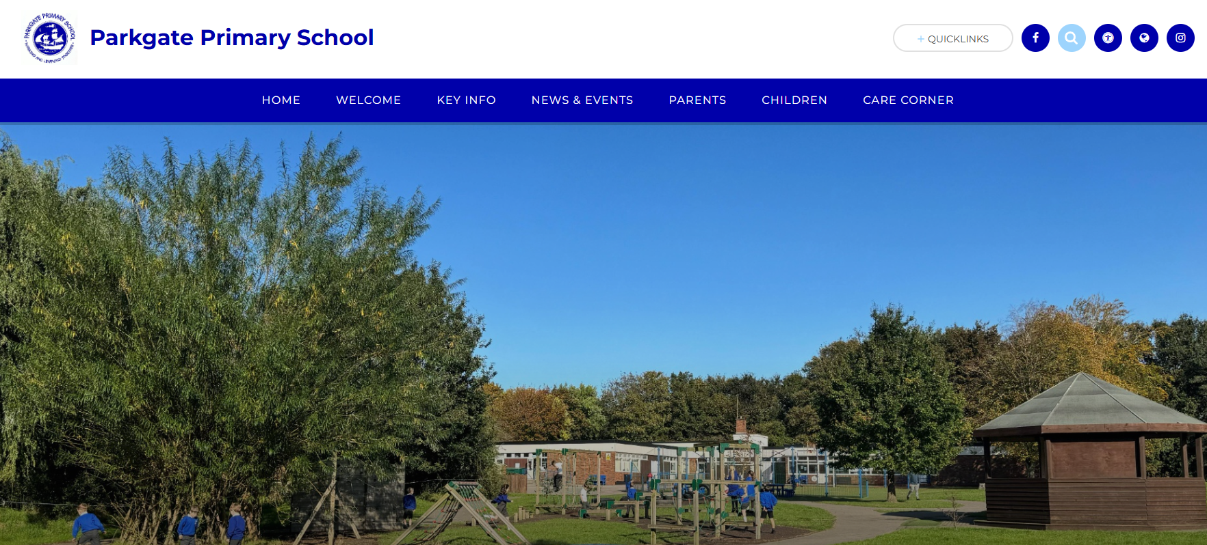
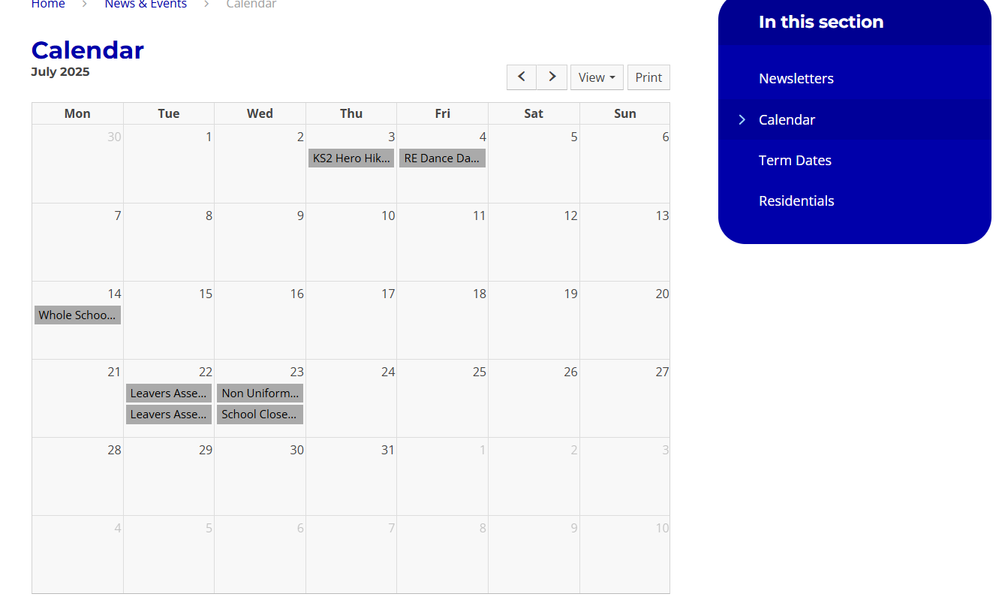
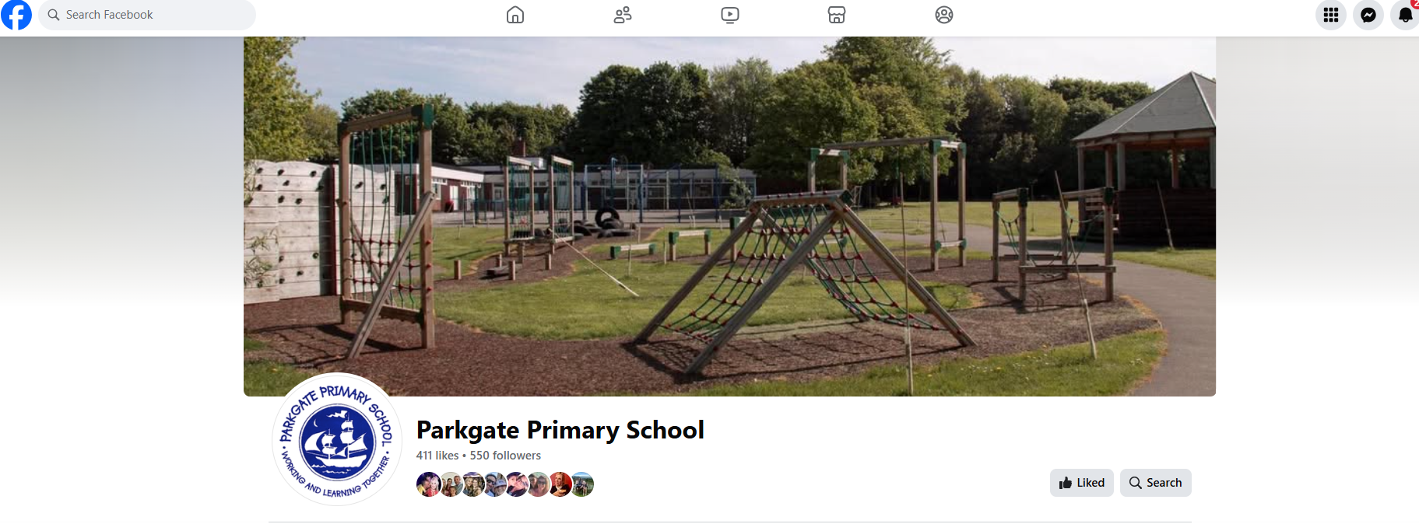
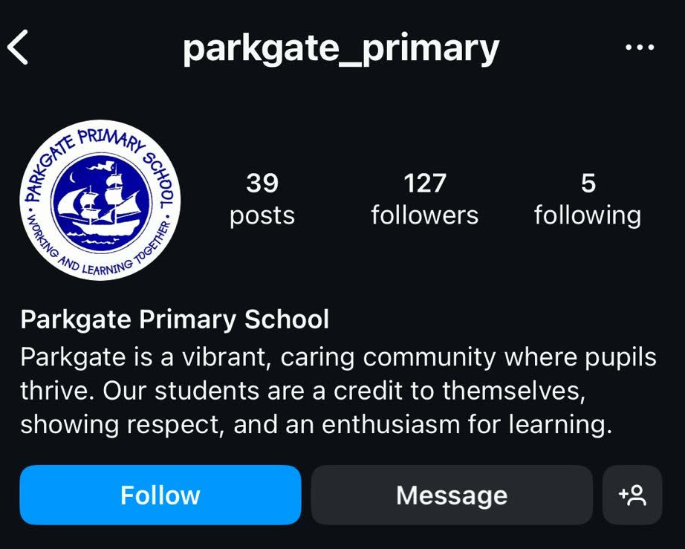


Communication Tools
Social Media Platforms :
School Website
School Calendar
All events and important dates
can be found on the school calendar.
Facebook
Instagram

Slide 9

Communication Tools
We have 3 different electronic platforms to communicate between home and school.
General notices and information about school, e.g. school events, dates, trips, lunch payments etc :
More information on ‘Schoolgateway’ will be given to you by the office
Class email: Information about your child (between home and school) tigers@parkgate.cheshire.sch.uk or penguins@parkgate.Cheshire.sch.uk
Google classroom: Information relevant to your class only. Used for quick updates and messages and weekly homework.

Slide 10
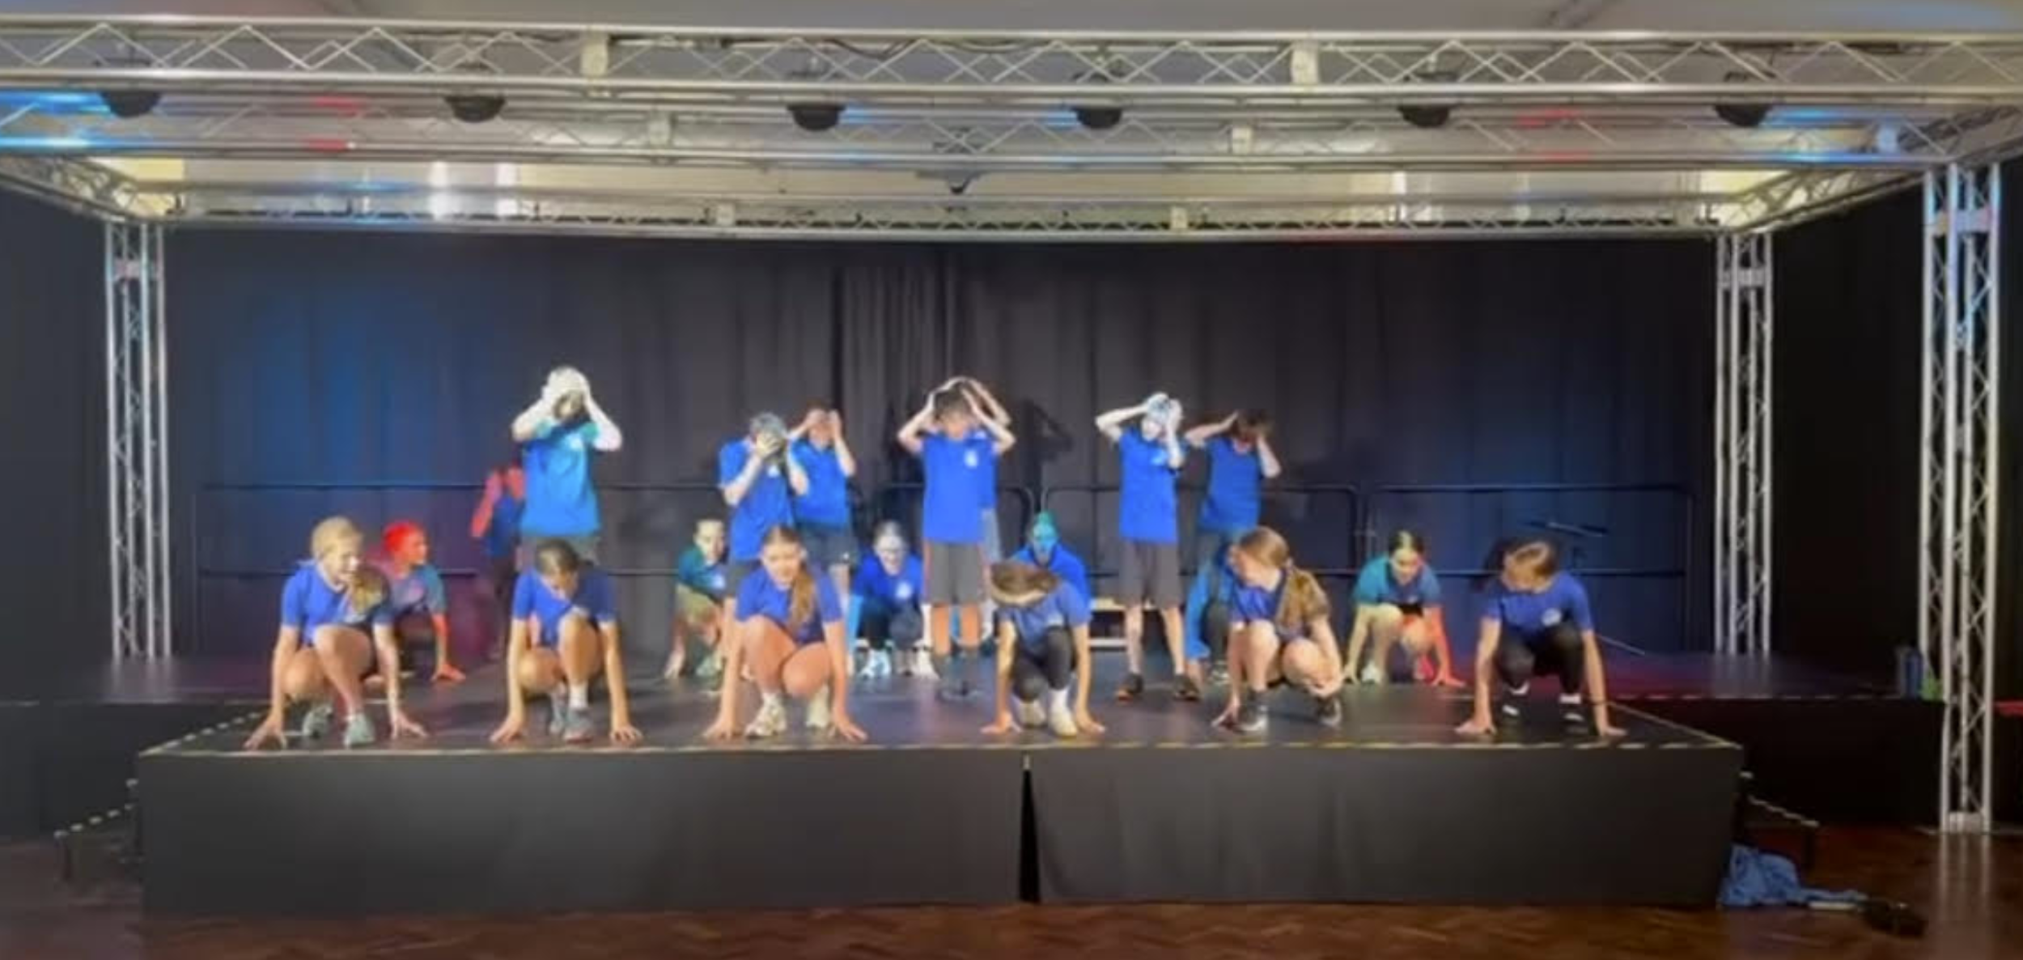
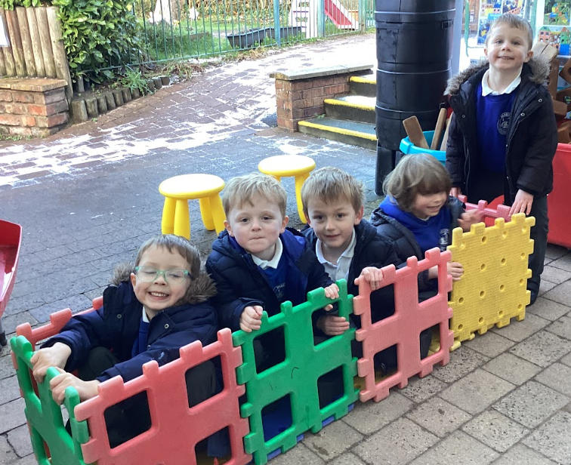
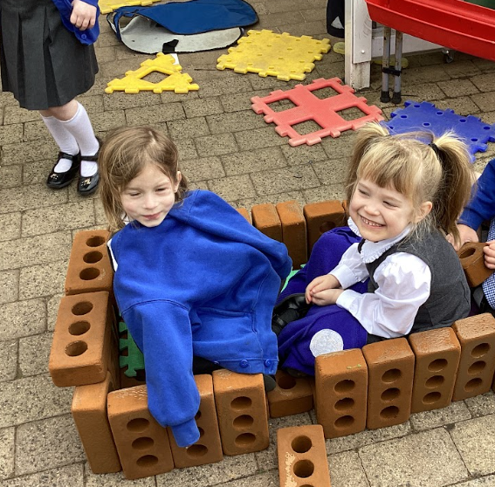
Parents & Teachers Association
PTA
Please join our PTA.
What do they do?
The PTA have raised money through many fun family activities, fairs, collections etc. And it is all for our children’s learning.
They have purchased numerous things over the years…
To name but a few: guided reading books, equipment for the
science department & EYFS class and the outdoor classroom on
the field. The most recent project was raising funds for the
spectacular stage in the hall.
They meet once a term to make all the magic above happen.
Please contact the office if you would like to be apart of this ‘dedicated and all volunteers’ group.
On Wednesday 16th July at 3:15 pm, the PTA will be holding a uniform sale in the hall. A great opportunity to maybe buy your child some spare uniform?

Slide 11
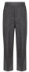

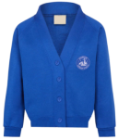
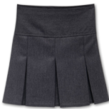
The Parkgate Primary School PTA Uniform Shop!
We have a range of high quality second hand items, from uniform to shoes and coats, in an array of sizes
Prices are low (20p - £2), and it’s open to everyone. The idea is to help everyone to save the pennies while also helping the environment.
The shop will normally run each half term, after school in the main hall. Dates will be announced via school email system
The next date is Wed 16th July (main hall, 3.15pm) – Please feel free to come, browse, and pick up a bargain!
If you cannot make the next date, but would like some uniform, please contact Kim on Kimirisbaker@gmail.com
If you’d like to donate any uniform, please hand it into the
school office. Thank you!
Notes:
‹#›

Slide 12

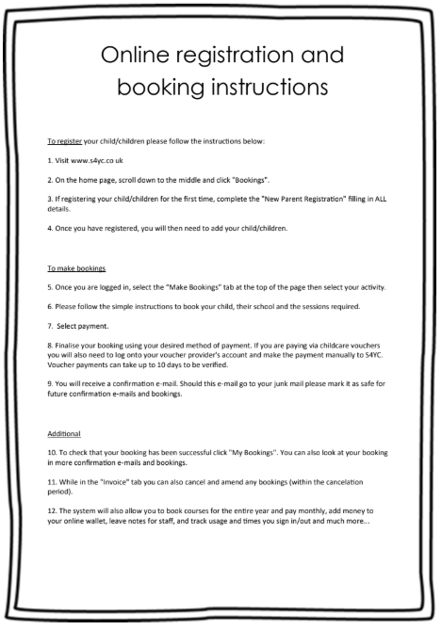

S4YC
S4YC specialise in childcare, preschool, sporting activities and wrap-around care, including school holidays for children 3 -11 years of age
For more information, please go to their website
www.s4yc.co.uk
or contact

Slide 13
Please see our school website: https://www.parkgateprimary.org.uk
We will add this power point onto your section and other pieces of information which you and your child may need
Please browse the other pages for, our curriculum, term dates, staff list and other information about the school
If you have any queries or any concerns, please do not hesitate to email the Lion Cub team penguins@parkgate.cheshire.sch.uk tigers@parkgate.cheshire.sch.uk
Thanks again and have a lovely evening.
Thank you for your time

