Slide 1

‘Meet the teacher’
Mr Hewson

Slide 2
A Typical Day
8:40 - Gates open
8:50 - Gates close (late mark after this time)
8:40 - Morning work (SPAG & Maths)
8:55 – Start morning lessons.
Spellings, Guided Reading
English
10:50am – breaktime (Healthy snacks can be sent in for breaktime)
Maths
12:15pm – Lunchtime
1:15 – 3:15 – Foundation lessons
PE days
Wednesday and Thursday with Mr Kelly

Slide 3
Homework
Set on Google Classroom:
Spellings
English – writing/comprehension/ SPAG
Maths

Slide 4
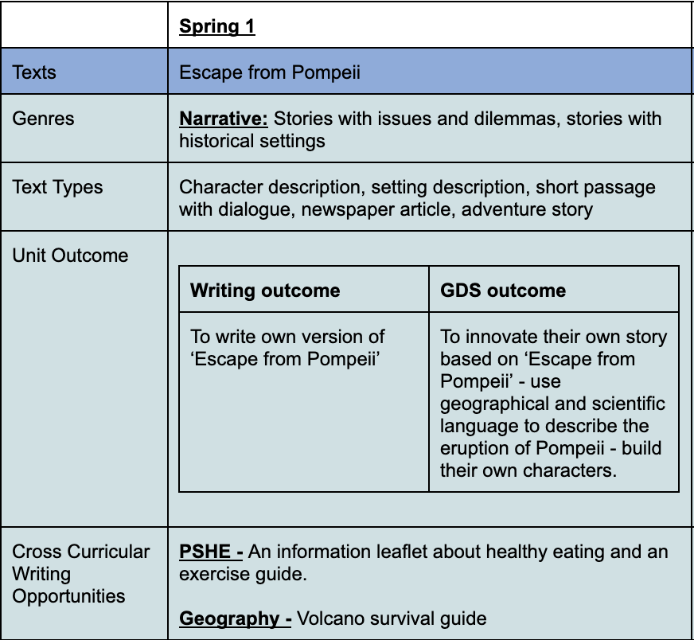
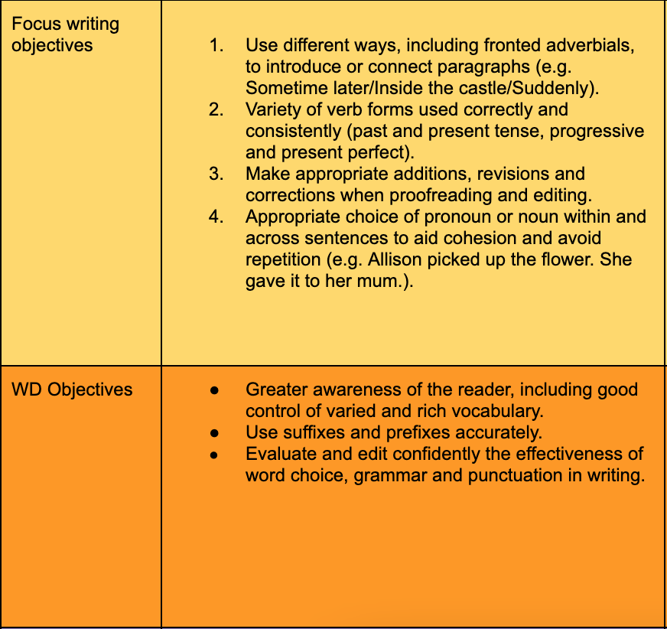
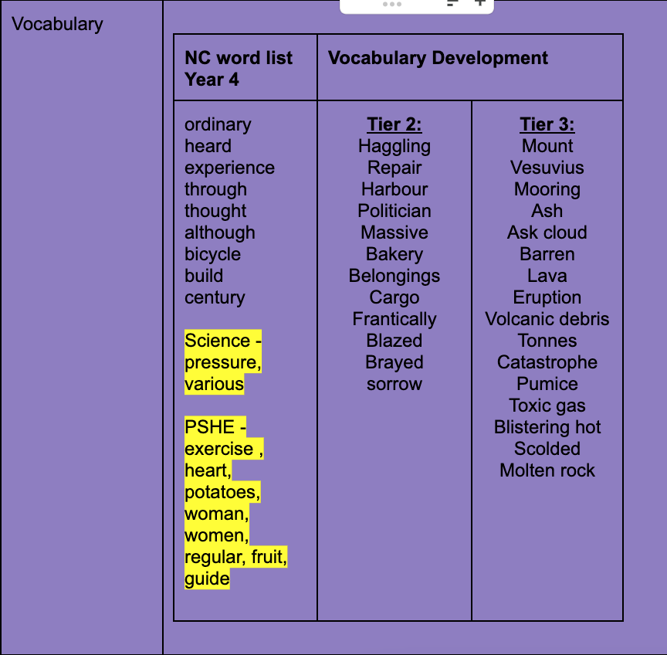
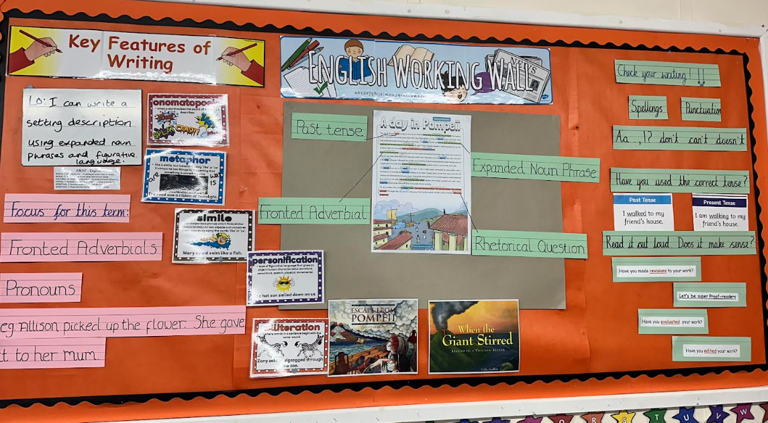
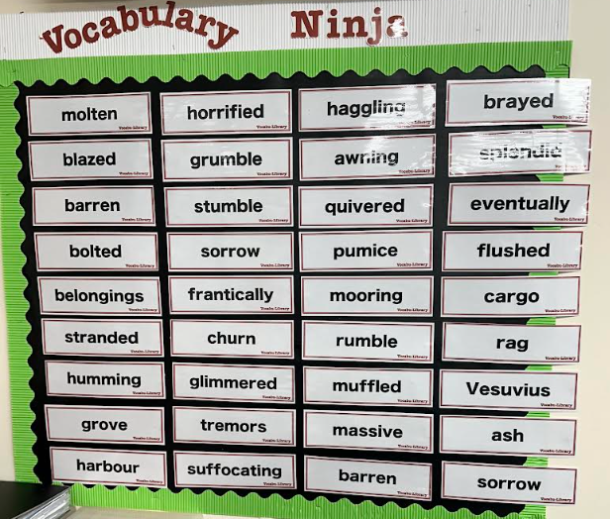

English Lessons – Text based approach
Notes:
Our English lesson are planned like this. We carefully select books suited to topics and year group, map out our national curriculum objectives and then teach in a sequence of lessons that lead up to a variety of different writing pieces.

Slide 5
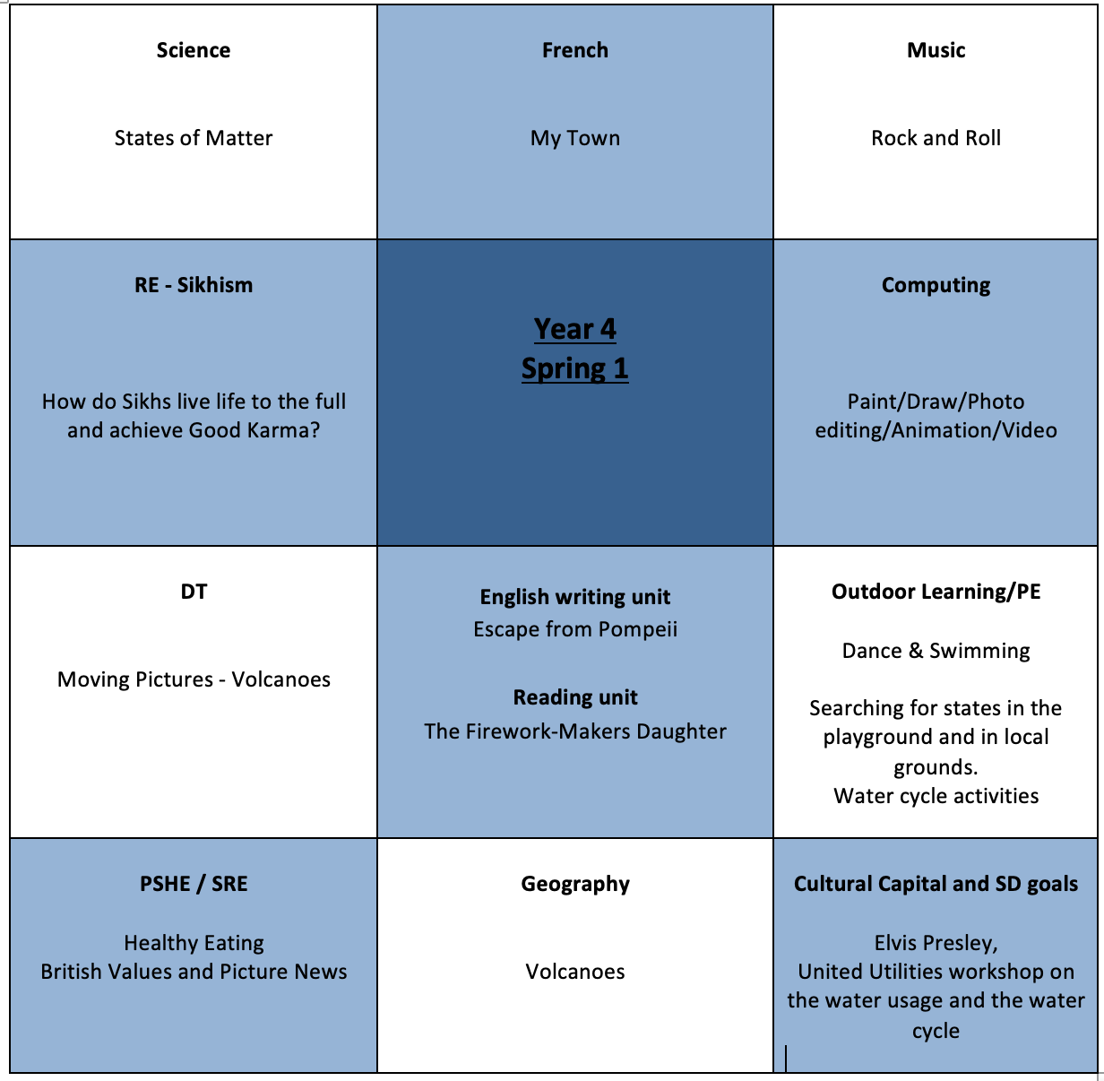
We look at solids and liquids linked to a volcano – e.g. when lava solidifies
We use I can Animate to re tell the story of Escape from Pompeii – story language and of course geographical language
We use different mechanisms to create an explosive volcano - we use our geographical vocabulary here to explain the features of a volcano
Cross curricular writing
How to Survive a volcano!
Notes:
This is how we map out our topics.
You will see that the vocabulary that we have mapped out link into our other topics which supports cross curricular reading and writing.

Slide 6
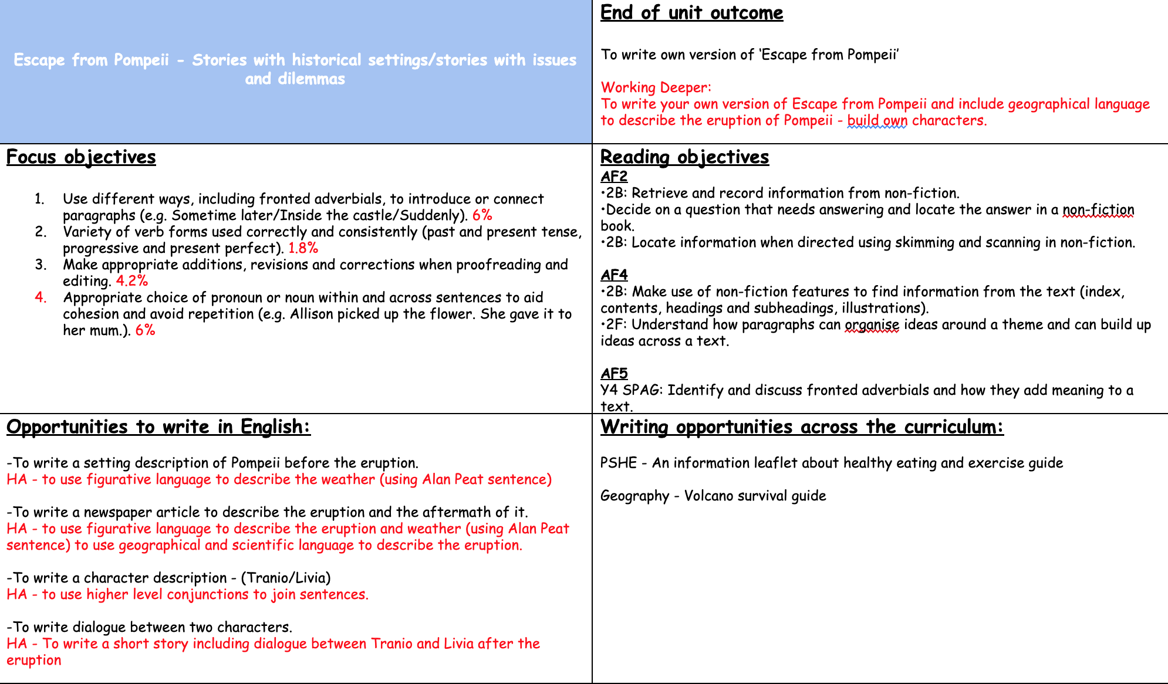
Notes:
This is our Medium term plan

Slide 7
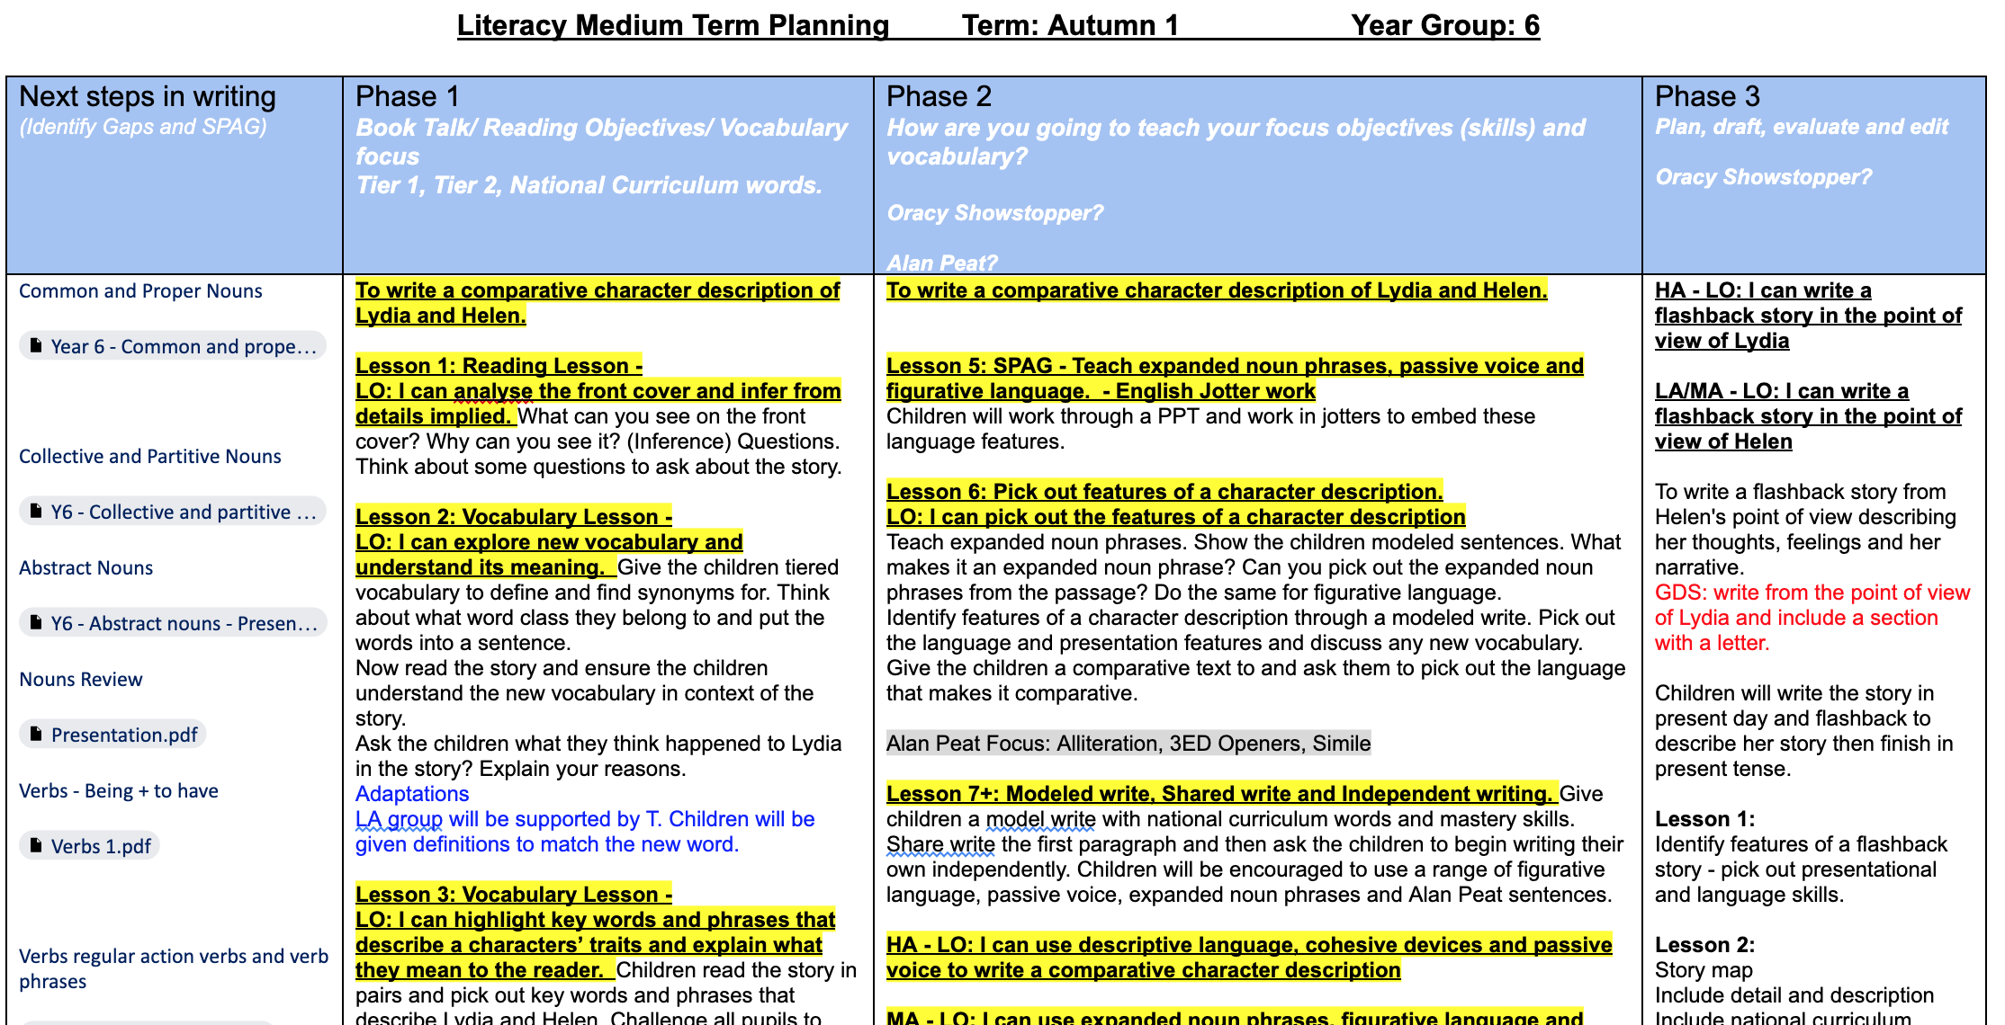
Notes:
This is a year 6 example

Slide 8
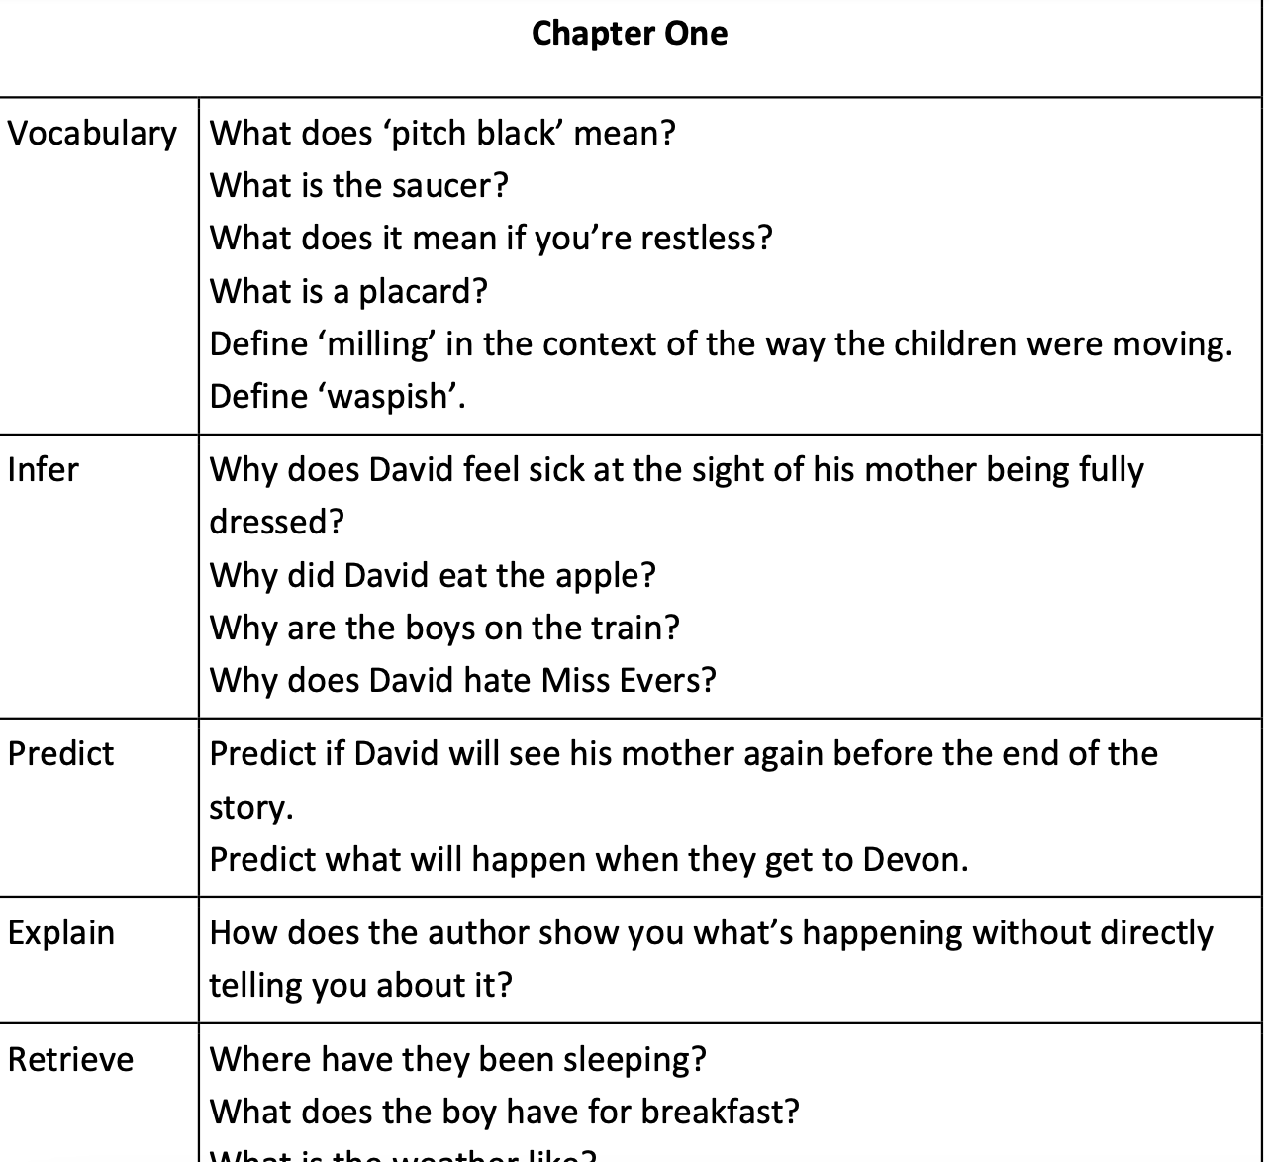

Guided Reading
VIPERS scheme
Notes:
This is how we teach guided reading. We use the VIPERS scheme – vocabulary, inference, prediction, explain, retrieval, summary.
These are the key reading areas that we focus on and assess.

Slide 9
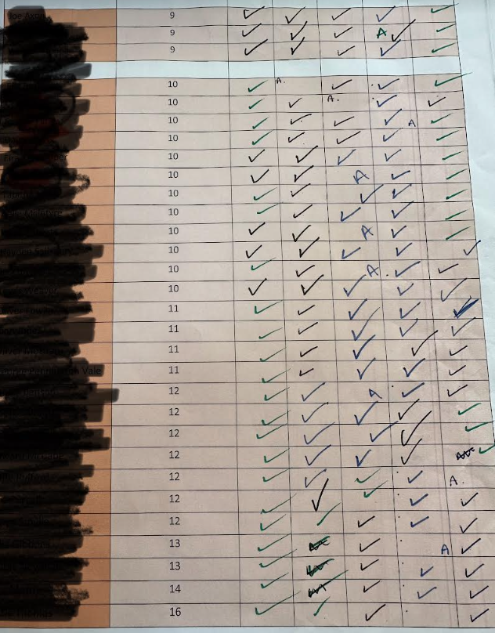
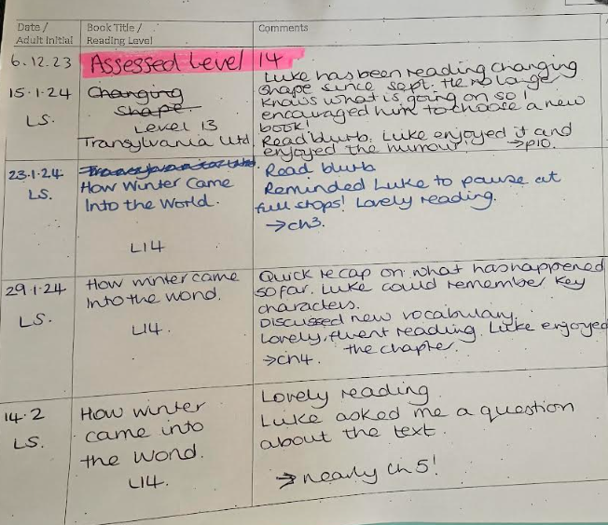
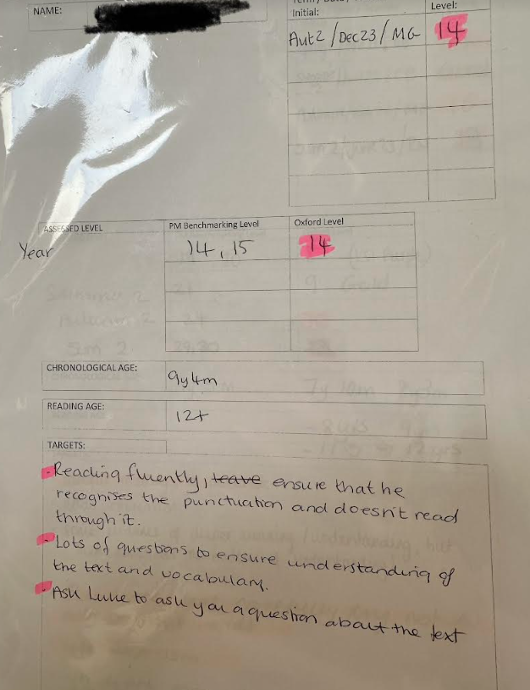
Reading Folders
Termly assessments, children are tracked from year 2 up to year 6 in Oxford Levels.
Lowest 20% identified and they become our target readers
Reading rangers help to support a child’s personalised target

Slide 10
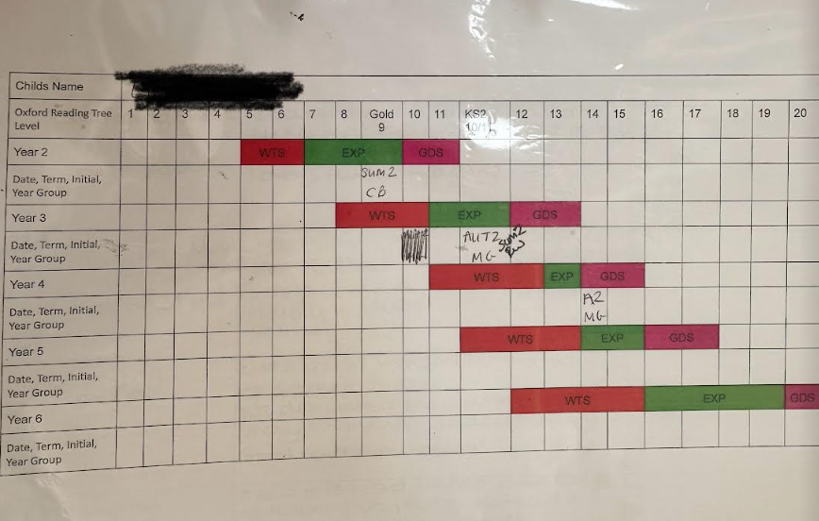
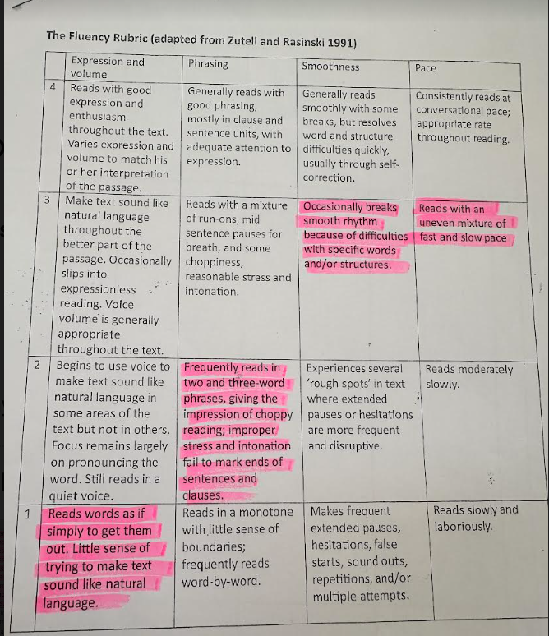
Notes:
This shows us the expected bands for each year group and our high ambitions for where we think pour children should be at Parkgate.
The fluency Rubric is something we use with our lowest 20% of children who are not fluent readers. This helps us to identify specific targets for fluency.

Slide 11
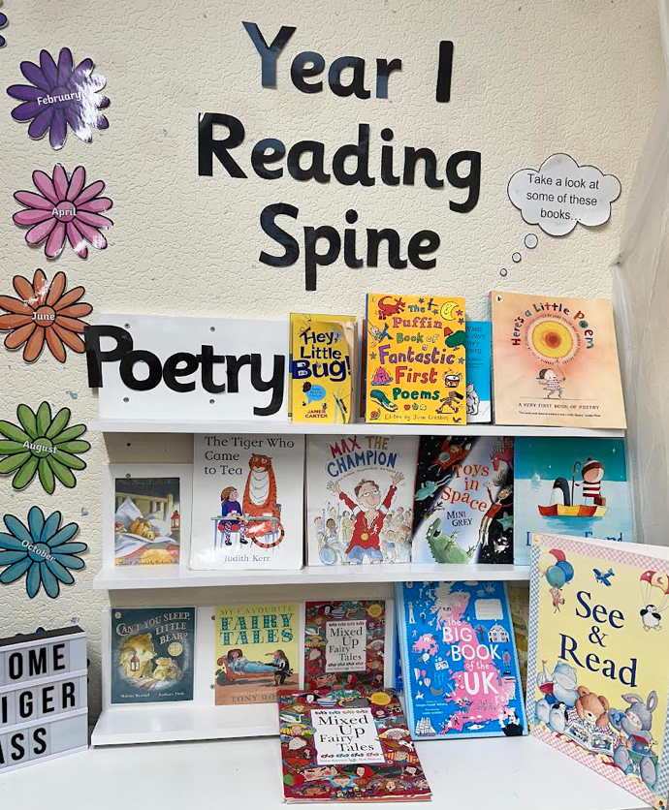
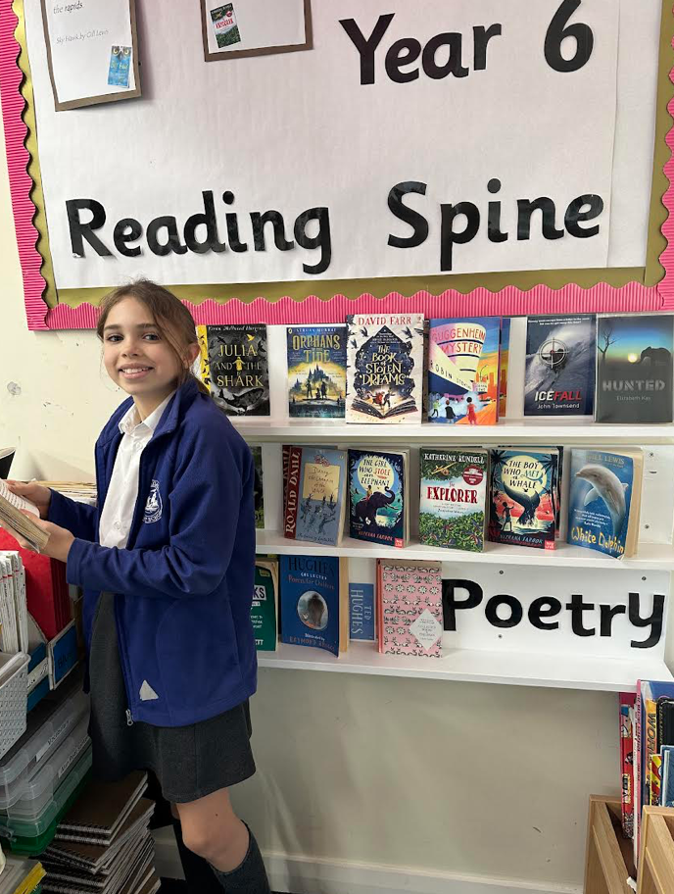
Reading & Poetry Spine inspired by Pie Corbett
Reading spines are changed half termly and some link with the topics being taught.
We have a range of high quality classical to modern texts including diversity
Notes:
Reading spines are changed half termly and some link with the topics being taught.
We have a range of high quality classical to modern texts including diversity

Slide 12
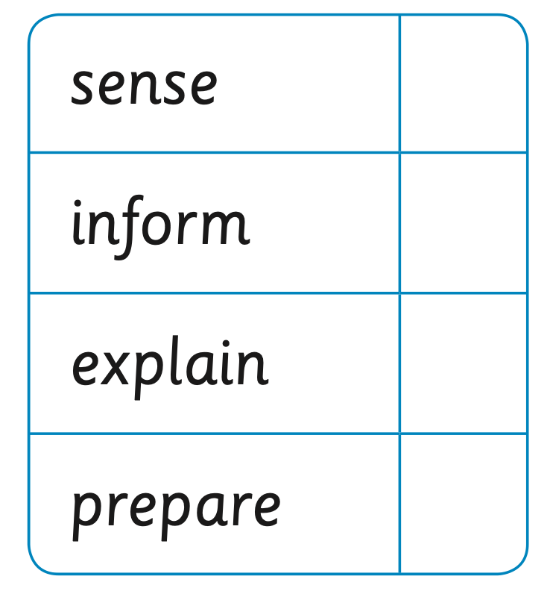
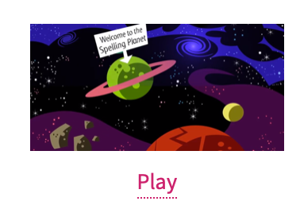
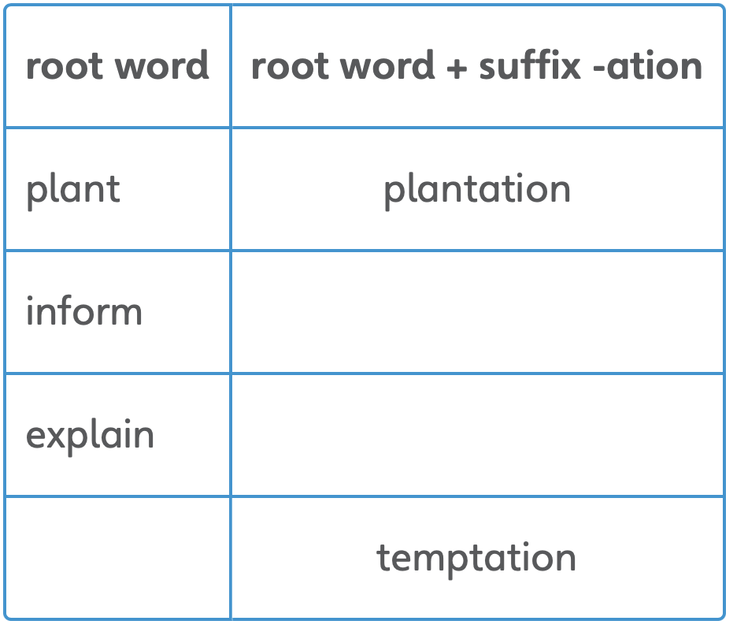
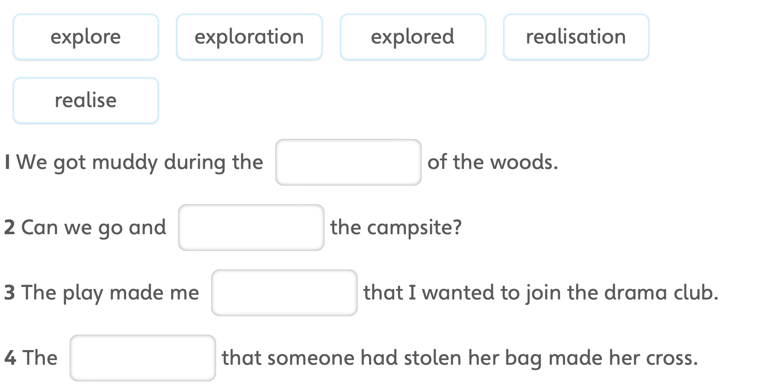
RWI Spellings
Dots and Dashes
Adding -ation to verbs to form nouns.
Choose the right word!
Word changers
Notes:
This is an example of the spelling strategies we use at Parkgate. We use a spelling scheme called RWI spellings which starts in Y2 to Y6. This supports a consistent teaching and learning approach across the school.

Slide 13
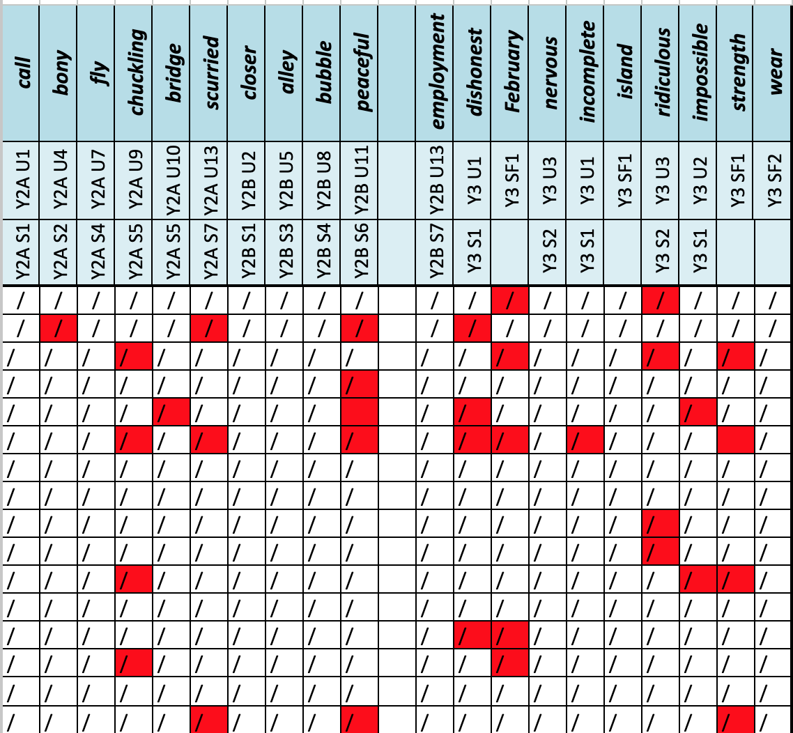
Lowest 20% identified from Balance for reading and writing. Interventions are planned and evaluated half termly during pupil progress.
Notes:
This is our spelling assessment spreadsheet which teachers fill in after each test. This helps us to quickly identify pupils that need support.

Slide 14
Topics
Our learning is linked to a half termly theme where possible and this is always shown on the class webpage. Some of the themes for Year 6 are:
Victorians
Crime and Punishment
Western USA
Sculptures
Earth and Space
Musical Composition
Data Handling

Slide 15
Trips & Residentials
Where possible we try to include trips and visits linked
to our learning:
Victorians
Crime and Punishment
Chester University - Hockey
Plus some whole school trips:
Panto
Chester Zoo
And an overnight residential stay for Year 6 in June
Plas Caerdeon

Slide 16
Class Webpage
https://www.parkgateprimary.org.uk
Key info
Class Pages
Meerkats - Year 5

Slide 17
Important Information
Attendance: The Importance of coming into school
-School’s attendance figure is 97%
Illness
Please ring school/email before 9.00am if your child is going to be away from school due to illness. We will contact you if your child is not present and we haven’t received a phone call/email by 9:30am.
Holidays
We do discourage taking any holiday time off during term time. If you wish to take your child out during term time, please let us know in writing using the ‘Leave of absent’ form, found on our website. The Head teacher can only authorise absences under certain circumstances.
Local authorities will fine families if they take more than 5 consecutive days off.

Slide 18
Important Information
Medical Issues
Please ensure that you inform us of any medical issues and/or medication that your child needs.
Medication
Any medication such as inhalers or Epi-pens etc, must be brought into school in a container clearly labelled with your child’s full name and class name. This must be handed to an adult.
It is up to the you to ensure that all medication is in date.

Slide 19
Whatsaap groups and mobile phones

Slide 20
Thank you for your time
We will add this PowerPoint onto our class page and Google Classroom
Please browse the other website pages for term dates, staff list and other information about the school
If you have any queries or any concerns, please do not hesitate to email
meerkats@parkgate.cheshire.sch.uk

